Slide 1
Chapter 6 Color Image Processing

Slide 2
6.1 Color Fundamentals

Slide 3
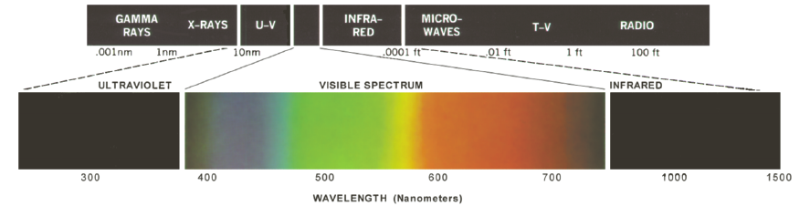
6.1 Color Fundamentals
What is Red, Green, Blue, Yellow,…???

Slide 4
6.1 Color Fundamentals
Same color, but different spectrum.

Slide 5
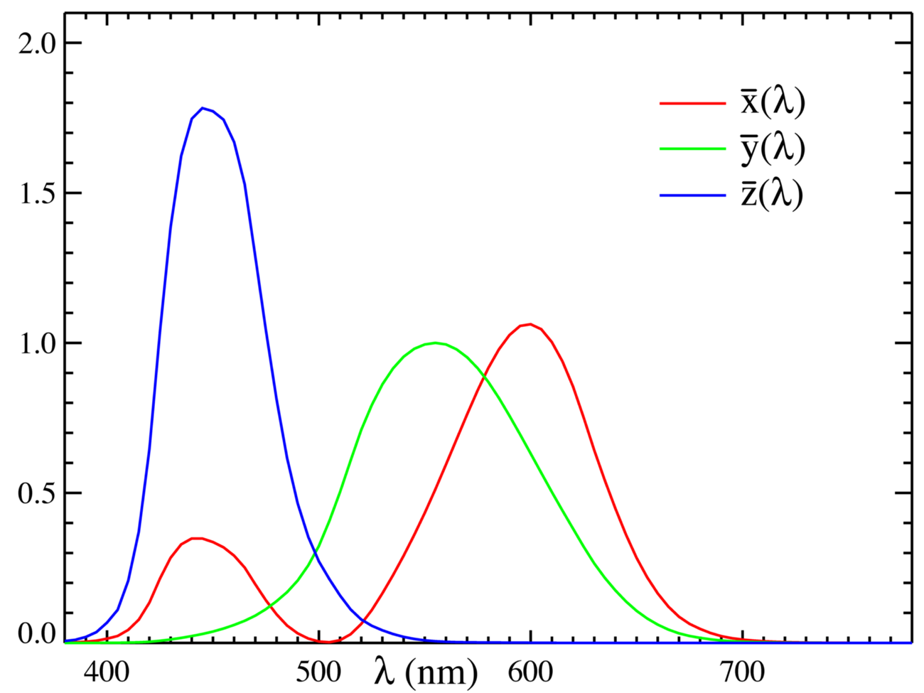
6.1 Color Fundamentals
Tri-stimulus Values : X,Y,Z

Slide 6
6.1 Color Fundamentals
Tri-chromatic coefficients

Slide 7
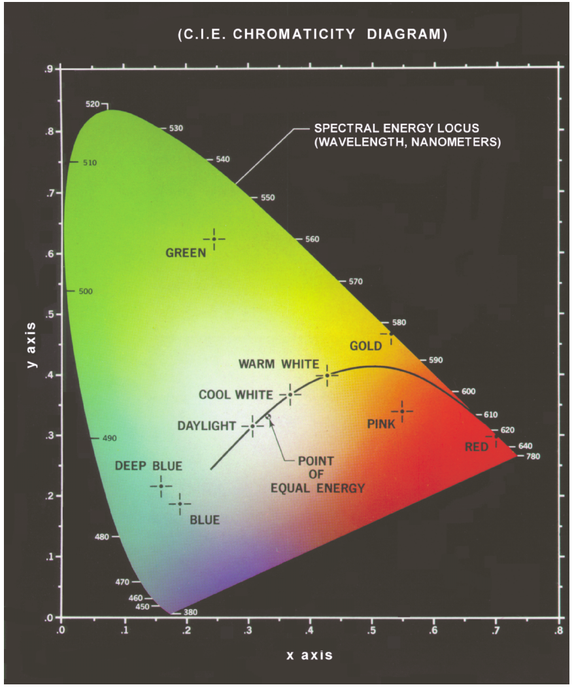
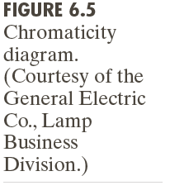
6.1 Color Fundamentals

Slide 8
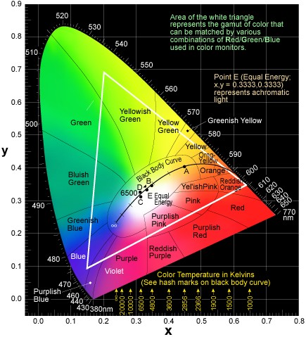
6.1 Color Fundamentals

Slide 9
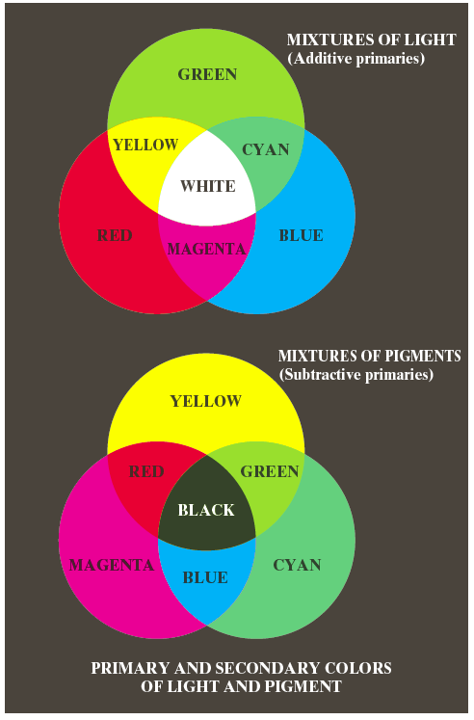
6.1 Color Fundamentals

Slide 10
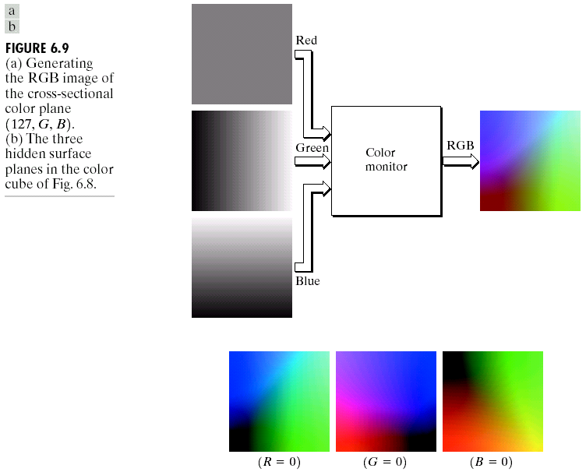
6.2 Color Model :RGB Model

Slide 11
6.2 Color Model
6.2.2 CMY and CYMK model
CMY Model:
C(CYAN)=[0 1 1]=1-R
M(MAGENTA)=[1 0 1]= 1-G
Y(Yellow)=[1 1 0]= 1-B
CYMK = CYM + Black, [full color printing]

Slide 12
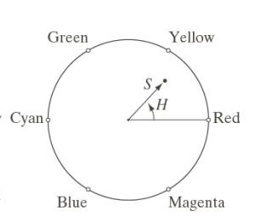
6.2 Color Model
6.2.3 The HSI Model
Hue, Saturation, Intensity
I = (R+G+B)/3
S = 1-min(R,G,B)/I

Slide 13
Don’t need remember!

Slide 14
HIS to RGB
Don’t need remember!

Slide 15


YUV Model
Y：Luminance、Luma
UV： Color

